Slide 1
Meta Elements and Page Structure
Module 5

Slide 2
Head

Slide 3
The <head> Element
The <head> element is a container for metadata, which is data about data
The <head> element always comes between the <html> element and the <body> element

Slide 4
The <head> Element
The meta data in the <head> element is data about our HTML document that is largely used by browsers and search engines
The data in the <head> element does not get displayed, with the exception of the <title> element
Meta data typically defines the document’s title, style, scripts, etc

Slide 5
The <title> Element
The <title> element displays on the page’s browser tab
A <title> element is required for all HTML docs
The <title> element is very important for search engine optimization (SEO) since it will determine where our web page is listed in a search

Slide 6
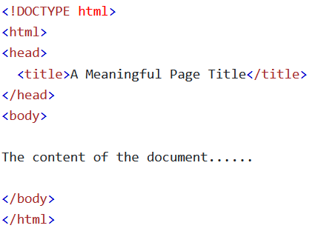
The <title> Element
Benefits of the <title> element
Defines the title on the browser tab
Provides a title if the page is favorited
Displays the title for a page in search engine results

Slide 7
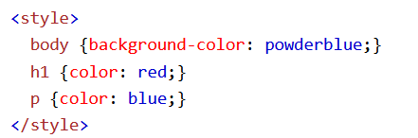
The <style> Element
The <style> element is used to define a style for a single page

Slide 8
The <link> Element
The <link> element “links” another page to the current one
The most common use of this is to add an external CSS file or an icon to your HTML doc
You can also use this to link to resources from another website entirely, like a special font from Google

Slide 9
The <meta> Element
Used to specify the character set, page description, keywords, author of the document, and viewport
Data inside the <meta> element will not be displayed anywhere on the page

Slide 10

Meta Examples
Defining the Character Set (UTF, ASCII, etc)

Slide 11
Meta Examples
Defining keywords for SEO

Slide 12
Meta Examples
Defining the description of your web page

Slide 13
Meta Examples
Defining the author of a web page

Slide 14

Meta Examples
Determining how often to refresh the page (in seconds)

Slide 15
Meta Examples
Setting the viewport size

Slide 16
Setting the Viewport
The viewport is the visible area of the browser
Different sized devices lead to different sized viewports
The following <meta> element will handle this for you

Slide 17
Setting the Viewport
This <meta> element tells the browser how to set the pages dimensions and scaling
width=device-width sets the width of the page to follow the screen-width of the device
initial-scale=1.0 sets the zoom level for when the page is first loaded

Slide 18
The <base> Element
The <base> element creates a base URL/target for all relative URLs in a page
The <base> element needs to have an href, a target attribute, or both
A document can only ever have a single <base> element in a single document

Slide 19
Layout

Slide 20
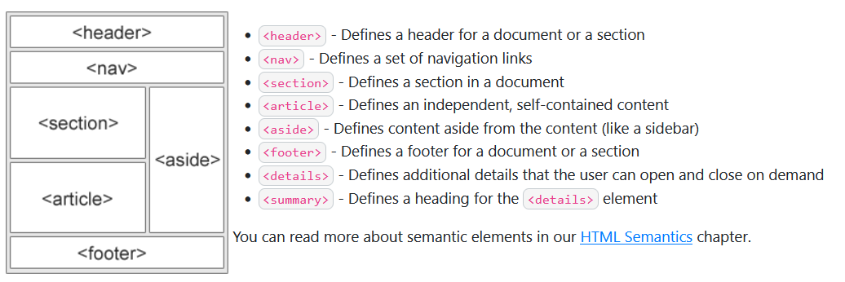
HTML Layout Elements
HTML has several semantic elements that determine the layout of the page
<header>
<nav>
<section>
<article>
<aside>
<footer>
<details>
<summary>

Slide 21
Layout Techniques
There are four different techniques to create multi-column layouts, each with its own selling points
A CSS Framework (Bootstrap)
CSS Float
CSS Flexbox
CSS Grid

Slide 22
Frameworks
Frameworks are used for speeding up development by giving developers premade tools to work with instead of building their own
The most popular Frameworks right now are Bootstrap and Tailwind

Slide 23
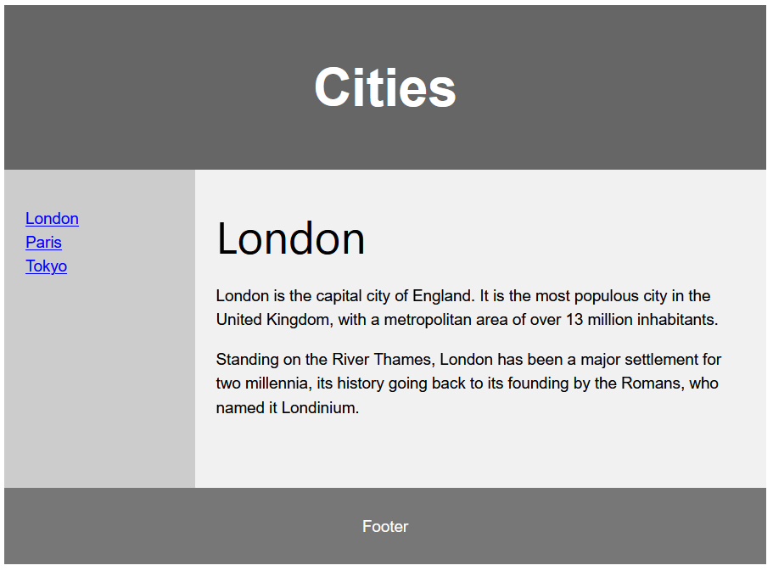
Float Layout
You can create entire websites using float
Floats are easy to learn and use, but can cause problems with the flow of the document

Slide 24
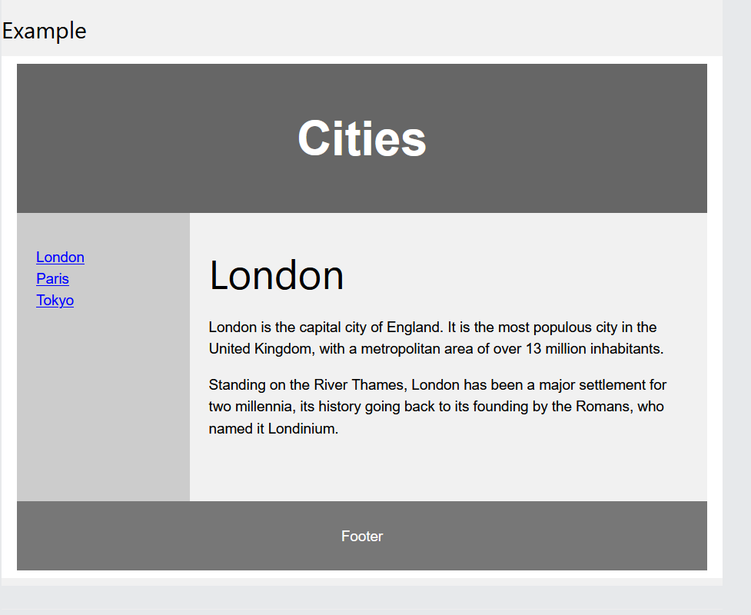
Flexbox Layout
Flexbox ensures elements behave correctly when using different screen/display sizes

Slide 25
Grid Layout
The CSS Grid layout gives us a grid system with rows and columns, which makes it easy to design layouts without having to use floats or positioning

Slide 26
Responsive

Slide 27
What is Responsive Web Design?
Responsive Web Design is about making websites that will automatically fit the website to the device
This will make sure that your websites look good on a laptop, a phone, tablet, etc

Slide 28
Setting the Viewport
For a website to be responsive, it is very important to have the following <meta> element:
It sets the viewport to make sure that the browser will resize appropriately

Slide 29
Responsive Images
Responsive issues will scale to fit any browser
If you set an images CSS width property to 100%, the image will be able to scale with the browser size
If you expand the browser, the image will stretch along with it

Slide 30
Responsive Images
We can prevent the image from getting larger than we intend it to be using the CSS max-width property
By setting CSS max-width to 100%, the image can never grow larger than its original size

Slide 31
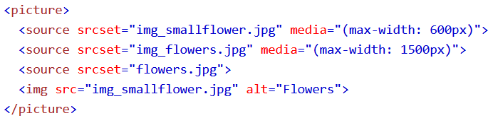
The <picture> Element
<picture> elements allow you to show different images depending on the size of the browser window
This is a great way to use an image of an appropriate resolution for different screen sizes

Slide 32
Responsive Text Size
The CSS font-size property supports viewport units, which will resize based on the dimensions of the viewport
We can create responsive text with vw (viewport width) units
1 vw (or vh) is equivalent to 1% of the viewport width (or height)

Slide 33
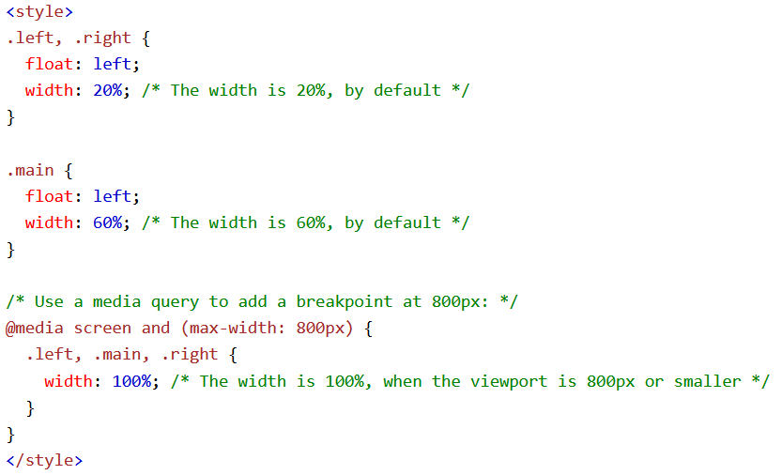
Media Queries
Media Queries are a key component of responsive design
They allow you to define completely different styles for differently sized browsers

Slide 34
Responsive Web Design - Frameworks
Every popular CSS Framework offers responsive design options
The two most popular CSS frameworks in 2023 are Bootstrap and Tailwind
We won’t get to cover any frameworks in here, but they offer UI elements that you can add to your pages as well as entire pre-built website templates

Slide 35
Semantics

Slide 36
What are Semantic Elements?
Semantic Elements clearly describe their meaning to both the browser and the developer
Non-Semantic Elements are elements like <div> and <span> which tell you nothing about what they contain
Semantic Elements are elements like <form>, <table>, and <article> where you can tell exactly what they are

Slide 37
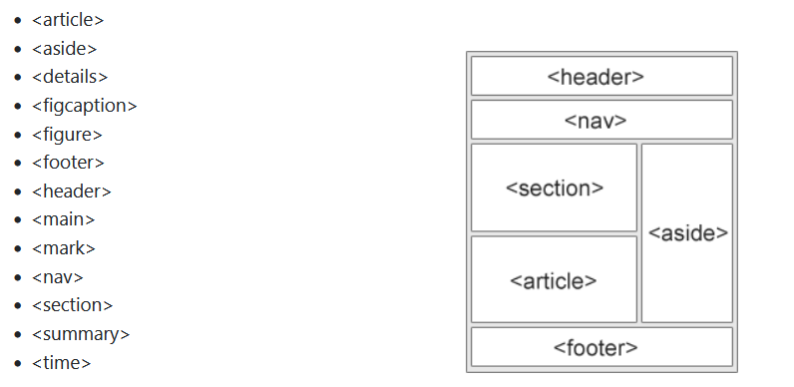
Semantic Elements
We can use Semantic Elements to define different parts of our web pages

Slide 38
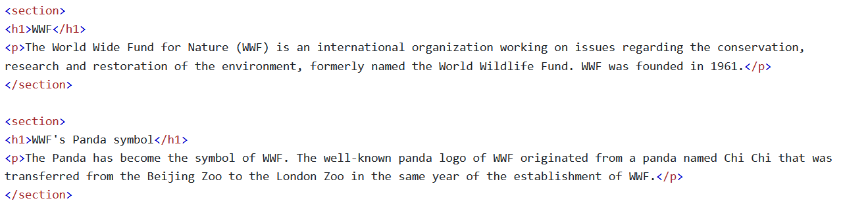
The <section> Element
The <section> element defines a section of a document
According to the World Wide Web Consortium (W3C), “a section is a thematic grouping of content, typically with a heading.”

Slide 39
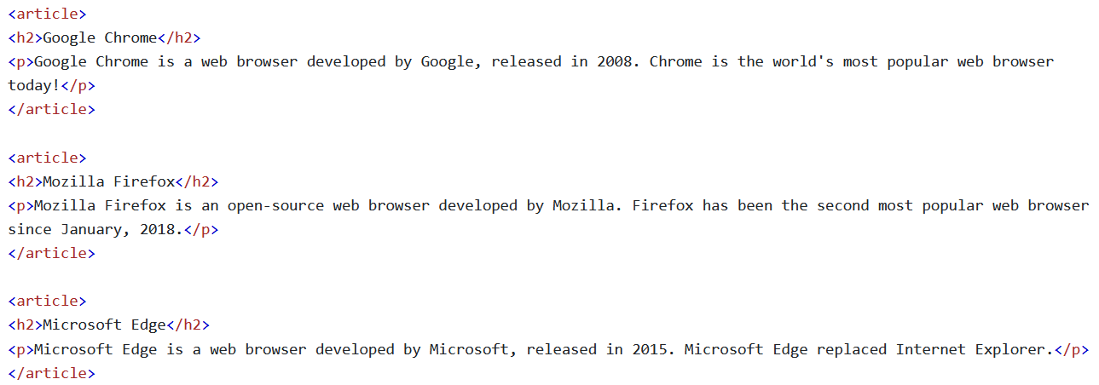
The <article> Element
An <article> element specifies independent, self contained content
Articles should make sense without being displayed on the website
Ex: Forum posts, Newspaper Articles, Blog post

Slide 40
Nesting <article> in <section> or Vice Versa?
An <article> is independent, self contained content
A <section> is a section of a document
Since these do not necessarily contradict each other, you can have <article> elements inside of <section> elements as well as <section> elements inside of <article> elements

Slide 41
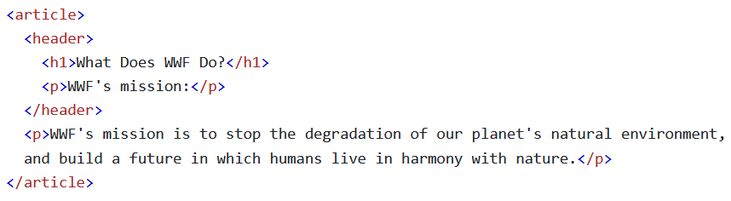
The <header> Element
The <header> element represents a container for intro content or a set of nav links
<header> elements are designed to be used at the top, or near the top, of an HTML doc
<header> elements usually have at least one heading element, a logo, and may have authorship info

Slide 42
The <header> Element
You can have multiple headers in the same HTML page, but a <header> cannot be placed in a <footer>, <address>, or another <header>
Although you can have multiple headers, be careful using more than one or your website will look strange

Slide 43
The <footer> Element
The <footer> element creates a footer for a document
<footer> elements generally have copyright info, contact info, a sitemap, a link to the top of the page, related documents, or authorship info
You can create multiple <footer> elements in the same doc, but be careful not to overdo it

Slide 44
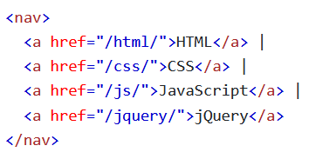

The <nav> Element
The <nav> element is a container for links to other pages
Almost all modern websites have navbars that allow you to link to other pages on the site
Not every link on your website should be included in the <nav> element, only links to your most important pages

Slide 45
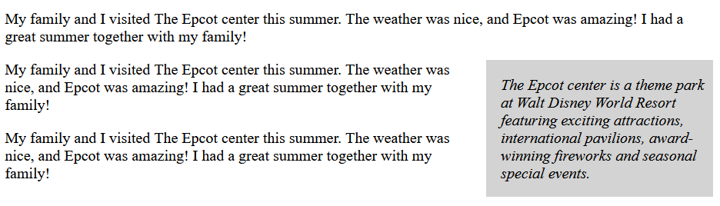
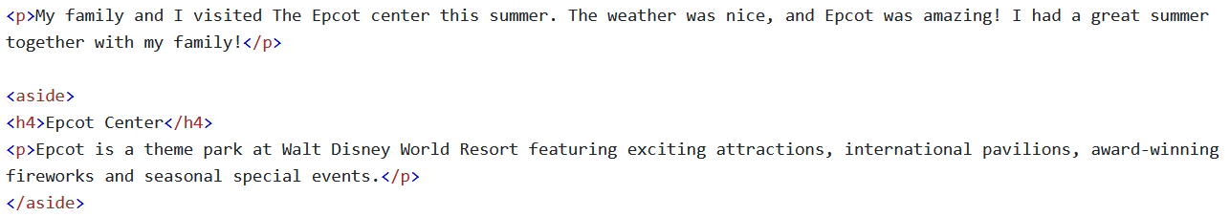
The <aside> Element
The <aside> element defines content meant to be off to the side on your web page
The content inside of it should be indirectly related to your surrounding content
<aside> elements are commonly used to contain advertisements

Slide 46
The <figure> and <figcaption> Elements
The <figure> element specifies self-contained content like illustrations, diagrams, photos, code listings, etc
The <figcaption> element defines a caption for a <figure> element. The <figcaption> element can be placed as the first or last child of a <figure> element
An <img> element creates the actual illustration

Slide 47
Why Use Semantic Elements?
What is the use for semantic elements if we can make the same visual designs without them?
Semantic elements are helpful for people with disabilities that may need screen readers
Increasing our PageRank in search Engines can increase our web traffic

Slide 48
Style Guide

Slide 49
Style Guide
Writing clean, consistent, and tidy HTML code will help other developers understand what is happening in the code we wrote
Better written code is much easier to work with
Code that does not follow any style guidelines makes the developer appear sloppy

Slide 50

Always Declare Document Type
The first line of every HTML document should be <!DOCTYPE html>
Your IDE might be able to infer what kind of document your HTML page is without it, but it can cause problems down the road

Slide 51
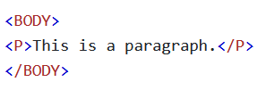
Use Lowercase Element Names
HTML allows you to write your element names with lower or upper case
Be sure to write them in all lower case because:
That is the convention
Other frameworks use PascalCase for naming elements (React.js)
Lowercase looks cleaner

Slide 52
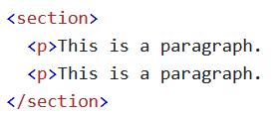
Close All Elements
Your browser may be able to interpret what you intended to do if you do not close your elements
This is not a sure thing, so it may cause bad interactions with other elements

Slide 53
Use Lower Case Attribute Names
HTML will let you name your attributes in upper or lower case
You want to stick to all lower case for the same reasons as with element naming

Slide 54
Always Quote Attribute Values
You may be able to get away with not quoting attribute values
You should avoid doing this, especially if there is a space in the value
HTML may not know where one attribute stops and the next begins

Slide 55

Always Specify alt, width, and height for Images
Alt is very important for individuals who require screen readers or if the image cannot be displayed
Defining the width and height of your images cuts down on flickering, since your browser will then reserve space for the image before it loads

Slide 56
Spaces and Equal Signs
HTML allows spaces around equal signs, but it is a bad practice in HTML
This is not the same in programming languages

Slide 57
Avoid Long Lines
Its inconvenient to have to scroll to the right when a line is too long to be read in a single screen’s width
Hit enter and continue on the next line when your line is getting too long

Slide 58
Blank Lines and Indentation
Don’t add blank lines, spaces, or indentation for no reason
Any time an element contains another element (like <body> with <p> elements inside it), the inner element should be indented once
W3Schools has strange recommendations on this
Notes:
W3Schools recommends that you do not indent or use tabs for indentation. This is EXTREMELY controversial if not outright wrong

Slide 59
Do Not Skip <title>
The <title> element is required in HTML
This element is much more beneficial than meets the eye (SEO, tab, favorites, etc)
Always make your titles accurate and meaningful

Slide 60
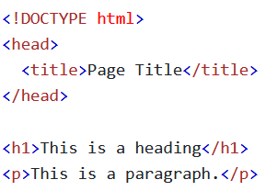
Omitting <html> and <body>?
You technically don’t need the <html> or <body> elements to display an HTML document
However, older browsers (IE) will likely crash
This will cause serious issues with JavaScript code trying to interact with your page

Slide 61
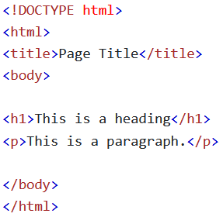
Omitting <head>?
You can get away without a <head> element, since the browser will create a default <head> element with everything before the body element
This will cause you to miss out on valuable metadata for SEO

Slide 62


Closing Empty Elements?
It is optional to close empty elements
If you expect to be XML/XHTML software to access your elements, it is required to keep the closing slash

Slide 63
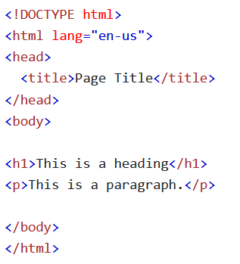
Add a Lang Attribute
Adding a lang attribute inside the <html> element will assist browsers and search engines

Slide 64
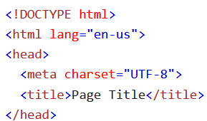
Meta Data
Declaring the charset meta element should be done as early as possible
This will assist with the indexing of your web page

Slide 65
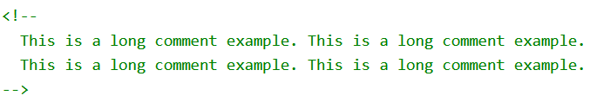

HTML Comments
Short comments should be written in a single line comment
Longer comments should be written in multiline comments

